Slide 1
Digital Payments On Buses
Done By
N. Logashri
P. Ramya

Slide 2
@ABSTRACT
The payment system used in buses is same old way of getting the ticket from the conductor. This is way more time taking since providing with the correct amount (change) is not possible every time.Also communication takes more time as compared to digital bookings. The bus conductor has to print tickets for every passenger after knowing their respective stoppage which takes comparatively more time as compared to digital payment and then the passenger should have that printed tickets in this hand if they missed mistakenly that will lead them to pay fine so to avoid this the digital payment is better and efficient.
So, The main idea behind this project is to collect the fare automatically using digital payment system. It will be designed to make travelling more comfortable for the people.

Slide 3
#INTRODUCTION
Everything in the world is smart and digitalized. Many advances have been made in the transportation sector too.
Demand of passengers for using bus network is higher because of being cheap and also because of having more coverage area.
So as per this project is concerned, the bus payment system would be different from that of the traditional way of paying.
There will be an interactive screen at the entrance of the bus where one has to choose the destination of his journey.After submitting the detail, a QR code will be generated which has to be scanned through the mobile application.
The app contains the user information along with an e-wallet for the payment. After a successful payment, a ticket would be generated.

Slide 4
OBJECTIVE”...
The main aim here is to avoid carrying change(in terms of coins) for the bus fare.
Implementation of this system can improve cleanliness in the bus as well as the surrounding areas as the tickets will be digitalized instead of being made of paper.
Digital mode of payment not only eliminates risk of using fake notes but also keeps an eye on the day earnings. For example, many conductors doesn’t provide ticket for his passenger and the money taken from them goes directly to his pocket which is considered to be black money.
It’s a small step towards Digital India.

Slide 5
EXISTING SYSTEM.....!
Automated Bus Fare Collection System using RFID was the paper presented by Sunitha Nandhini A – Assistant Professor,Department of Computer Science and Engineering,Sri Krishna College of Technology, Coimbatore
Sangeetha G and Vidhya Janani J – UG Scholor,Department of Computer Science and Engineering, Sri Krishna College of Technology, Coimbatore in IJARCET(International Journal of Advanced Research in Computer Engineering & Technology) Volume 6, Issue 3, March 2017, ISSN: 2278_1323.
The project was implemented using RFID/Smart Card which is given to the passenger.

Slide 6
SYSTEM DESIGN AND METHODOLOGY :-
This project will work using a mobile app with internet which will have all the necessary inputs and information of the user.
We make use of MySql server to store the database of the passenger using query language.
Also for making the mobile application we are making use of android studio where we code in java.

Slide 7
SYSTEM REQUIREMENTS &...
The setup requires operating system –
Windows 7 and above
SDK for android 4.2
along with android studio 2.0 and above.

Slide 8
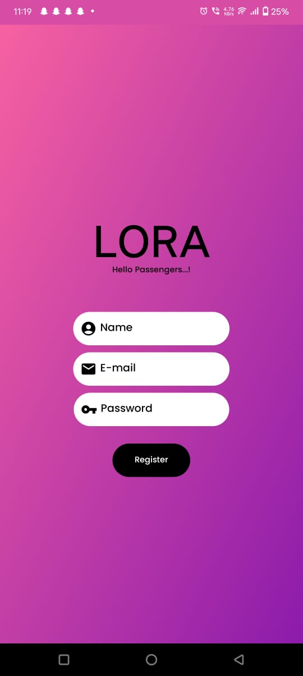
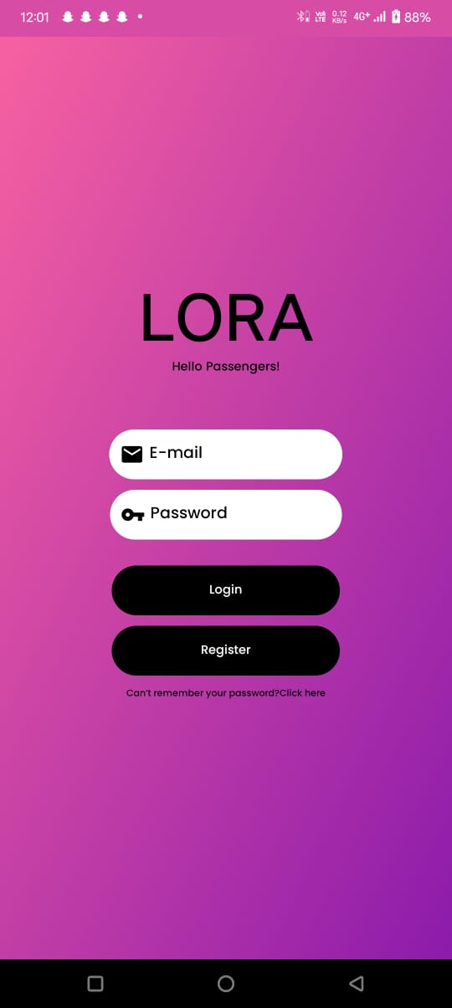
RESULT/-
REGISTER PAGE : LOGIN PAGE :

Slide 9
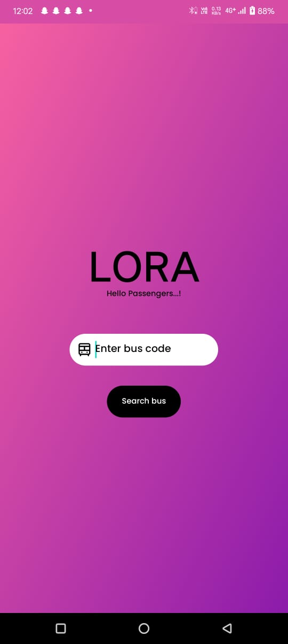
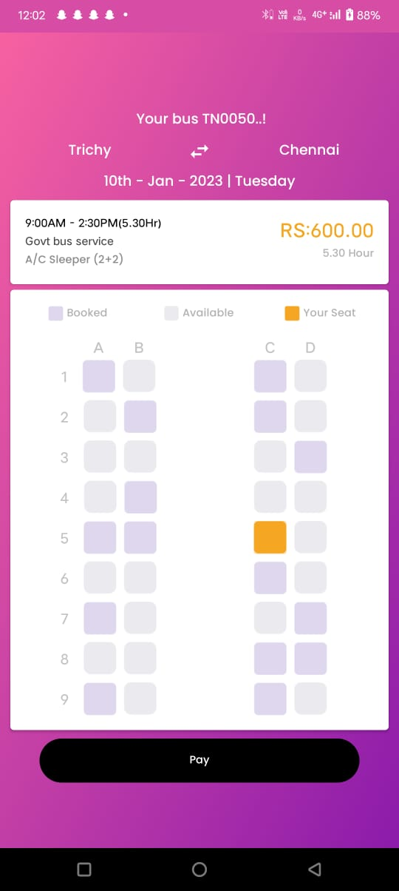
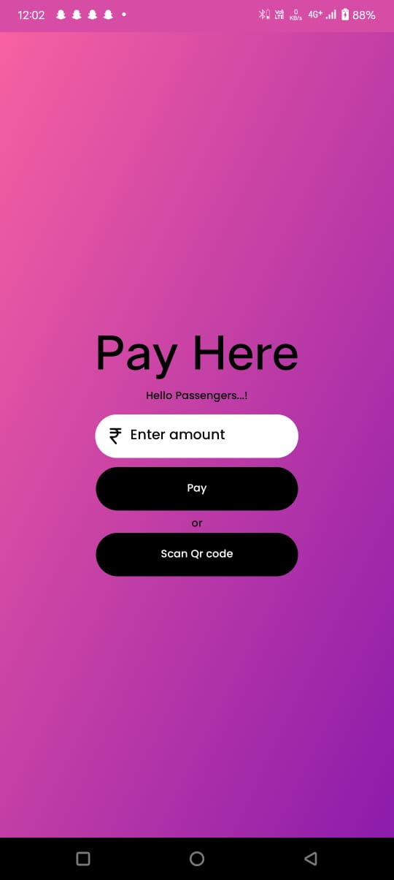
Screenshots
Here for payment we have to link bank and pan so we didn’t build further.... But in future We will implement...

Slide 10
CONCLUSION***
The system will be simple, user friendly, and will be made secure. This technology will be much more convenient compared to the paper based ticketing system.
This system not only promotes Digital India but also attracts many people towards the using new technology. Use of this system reduces payment time.
Also the passenger’s information are securely saved on the database along with their travel history.
Overall this project is implemented to make payment during travelling more convenient and more user friendly.

Slide 11
Github link –
https://github.com/ramya16-2002/LORA

Slide 12


